Slide 1
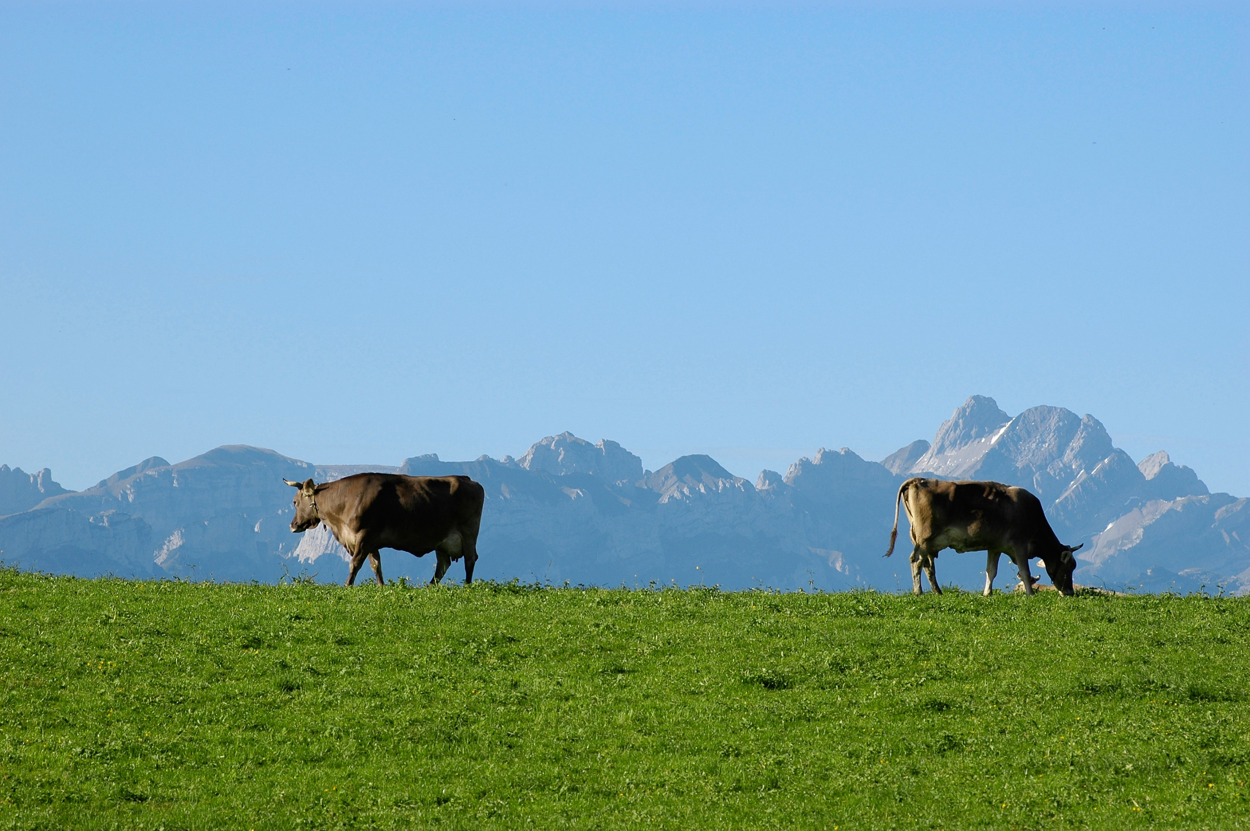

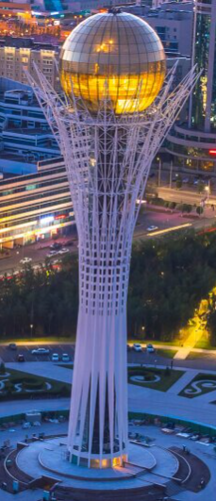

Implementing Causal Machine Learning in Friday: Planning the evaluation – next steps
August / September / October 2024
Michael Lechner Professor of Econometrics | University of St. Gallen | Switzerland

Slide 2
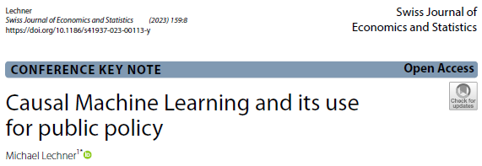
The workshop series
Astana Workshop September 30 to October 4, 2024 (10-13, 14:00-17:30)
Monday
Morning: Identification with experiments & selection on observables
Afternoon: Discussion of potential programmes to be evaluated
Tuesday: Causal Machine Learning (theory) (ends at 16:00)
Wednesday
Empirical examples: Active labour market programmes in Flanders
The mcf package – how to use it & how to interpret the results
Thursday: Doing an empirical study in groups with the data introduced in online workshop 4
Today: Discussion of programmes to be evaluated continued (core team only)

Slide 3
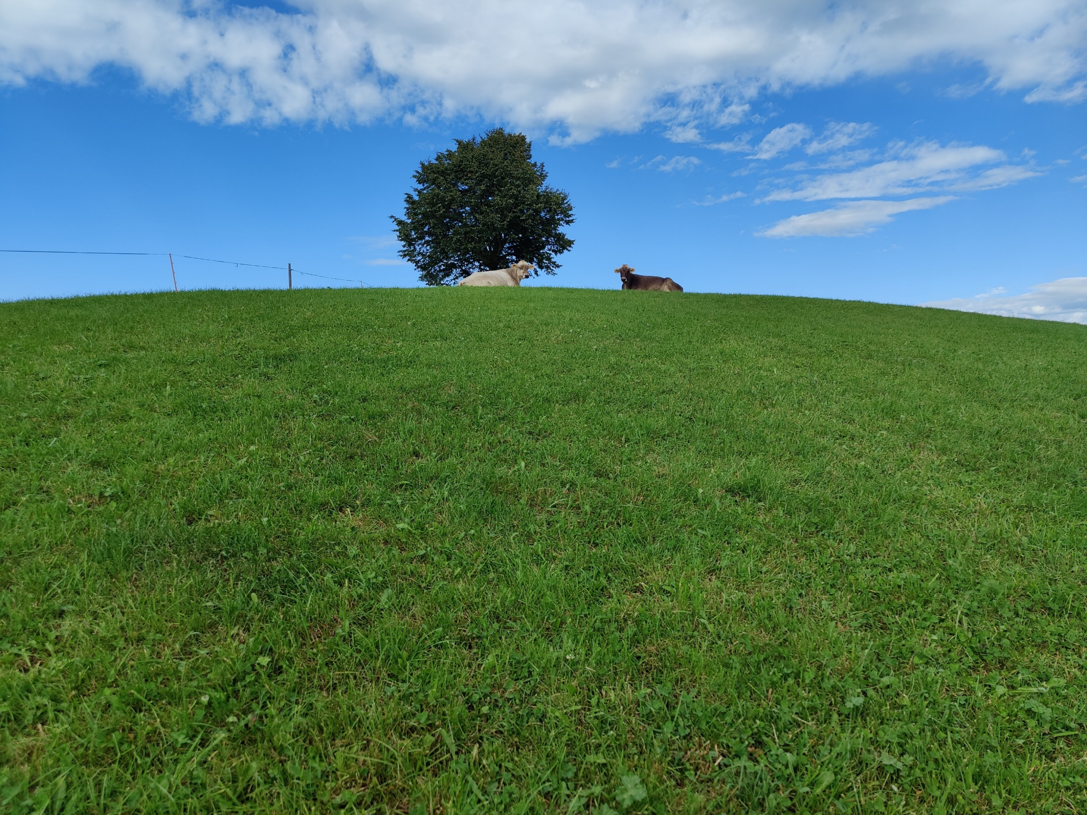
1 | Introduction
2 | Reflections on yesterday’s use of the mcf
3 | More information on candidate programmes, discussion, & decision
4 | Approximate Timetable
5 | How to interact from now on?

Slide 4
Reflections on yesterday’s use of the mcf
Please share reflections about the mcf’s usefulness for the planned evaluations
Small improvements that are also useful for others can still be implemented
New version (0.7.0) will appear in December 2024.

Slide 5
More information on candidate programmes, discussion, & decision
Which programmes are of interest AND …
are likely to fulfil identification criteria?
In particular CIA & common support
are big enough to have a chance to estimate heterogeneous effects?
for which the necessary data are available?

Slide 6
Approximate Timetable
Final decision on 1st programme to analyse: Today (?)
Data preparation (?)
Defining outcomes, confounders & heterogeneity variables (?)
If optimal policy analysis is conducted (?)
Policy class
Decision variables
Obtain results
Possible trial run on a smaller sample of the full data
Interpretation of results

Slide 7
How to interact from now on (core team & ML)?
Weekly online meetings of 1 hour?
Wednesday (9:00-10:00 St. Gallen time, 12:00-13:00 Astana time)?

Slide 8
Michael Lechner
Swiss Institute for Empirical Economic Research (SEW) University of St. Gallen | Switzerland

